Slide 1
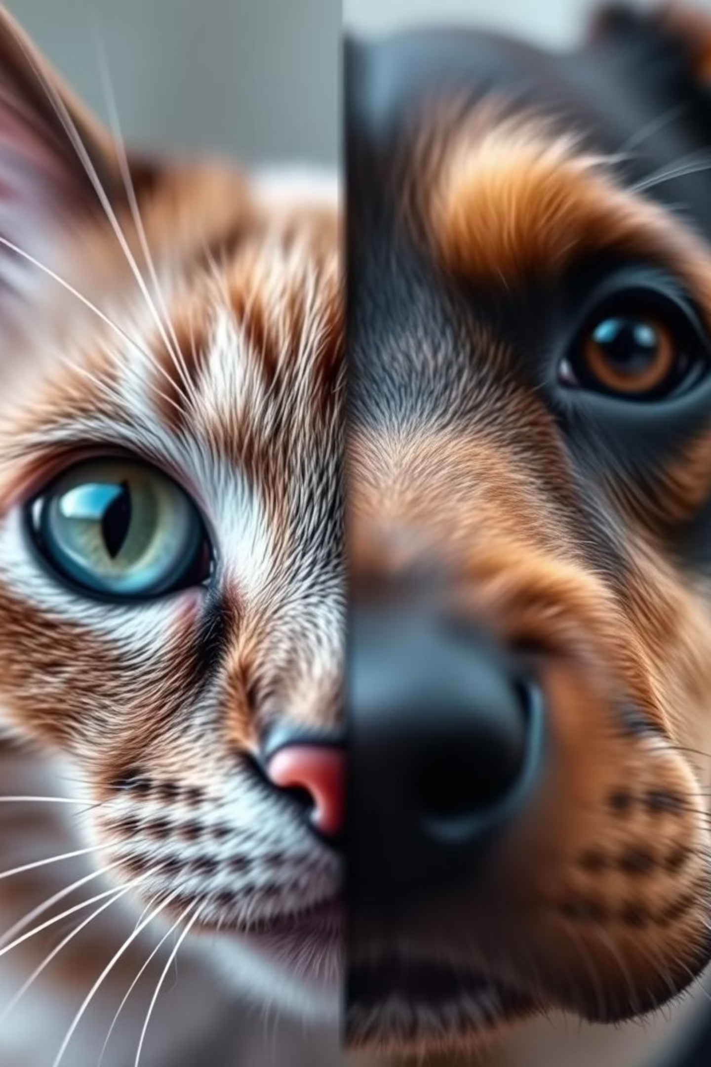
Image Clarification of Cats & Dogs Using CNN: A Deep Learning Approach
This presentation explores our deep learning methodology for enhancing and clarifying images of cats and dogs using Convolutional Neural Networks (CNNs). We will delve into the challenges of image degradation, traditional enhancement techniques, our custom CNN architecture, and the remarkable improvements achieved.

Slide 2



THE IMPERATIVE OF CLARITY
Understanding Image Degradation
Image degradation is a common issue affecting digital media, arising from various factors such as motion blur, low light conditions, camera shake, and sensor noise. These imperfections can obscure details, reduce visual quality, and hinder subsequent image analysis tasks like object recognition or feature extraction. Understanding these degradation types is crucial for developing effective clarification techniques that restore image fidelity and detail.
Motion Blur
Low Light Noise
Camera Shake
Caused by movement of the camera or subject during exposure, leading to streaks or smudges.
Introduced by inadequate lighting conditions, resulting in graininess and reduced clarity.
Random vibrations during capture, leading to overall image instability and softness.

Slide 3


JOURNEY TO SHARPER IMAGES
Pre-CNN Enhancement Techniques
Before the advent of deep learning, several conventional techniques were employed for image enhancement. These methods often relied on mathematical algorithms and statistical models to address specific degradation issues. While effective to a certain degree, they frequently faced limitations in handling complex, real-world noise patterns and preserving fine details.
Filtering Methods
Frequency Domain Techniques
Gaussian Blur: Reduces noise but can blur edges.
Fourier Transform: Converts image to frequency domain for easier noise removal.
Median Filter: Effective against salt-and-pepper noise, preserves edges better than Gaussian.
Wavelet Transform: Decomposes image into different frequency components, offering multi-resolution analysis.
Wiener Filter: Adaptive filter that minimizes mean square error, good for deblurring.
These techniques laid the groundwork for modern image processing, but often required manual tuning and struggled with diverse degradation types simultaneously.

Slide 4

UNLOCKING POTENTIAL
Introduction to Convolutional Neural Networks (CNNs)
Convolutional Neural Networks (CNNs) have revolutionised image processing due to their remarkable ability to learn hierarchical features directly from raw image data. Unlike traditional methods, CNNs automatically extract relevant patterns, making them highly effective for complex tasks like image clarification. Their core components, such as convolutional layers and pooling layers, enable them to identify edges, textures, and ultimately, high-level features crucial for reconstruction.

Slide 5




OUR METHODOLOGY
Dataset Curation & Preprocessing Pipeline
A robust dataset is fundamental to training an effective CNN model. For our cat and dog image clarification project, we meticulously curated a diverse dataset, ensuring a wide range of breeds, poses, lighting conditions, and background variations. The preprocessing pipeline was designed to augment this data and introduce controlled degradation, simulating real-world scenarios. This rigorous preparation ensures our model learns to clarify images across various conditions.
Image Collection
Data Augmentation
Gathering a large, diverse set of high-resolution cat and dog images from various sources.
Applying rotations, flips, and scaling to increase dataset size and variability.
Synthetic Degradation
Train/Test Split
Introducing controlled noise, blur, and compression artifacts to clean images.
Dividing the dataset into training, validation, and testing sets to evaluate model performance impartially.

Slide 6

DEEP DIVE
Designing Our Custom CNN Architecture
Our custom CNN architecture is designed specifically for image clarification, focusing on capturing both global context and fine-grained details. It incorporates several key components to achieve superior performance:
Encoder-Decoder Structure: An encoder compresses the image into a latent representation, while a decoder reconstructs the clarified image.
Skip Connections: These bypass certain layers, allowing information from earlier layers to directly feed into later layers, preserving fine details.
Residual Blocks: Help the network learn residual functions, making it easier to optimise deeper networks.
Attention Mechanisms: Focus the network's attention on more important features within the image, enhancing clarification in complex areas.
This combination allows our model to effectively learn and reverse various forms of image degradation.

Slide 7
TRAINING & FINE-TUNING
Optimising Model Performance
Training and fine-tuning are critical phases in achieving optimal model performance. We employed a strategic approach, utilising specific optimisers, loss functions, and regularisation techniques to ensure our CNN learns effectively and generalises well to unseen data. Iterative fine-tuning, involving adjustments to hyperparameters and network architecture, allowed us to push the boundaries of clarification quality.
Component
Description
Impact on Performance
Optimiser
Adam (Adaptive Moment Estimation)
Efficiently adjusts learning rates, accelerating convergence and improving stability.
Loss Function
Mean Squared Error (MSE) + Perceptual Loss
MSE measures pixel-wise difference; Perceptual loss focuses on visual quality and semantic similarity.
Learning Rate
Adaptive Scheduler
Dynamically reduces learning rate as training progresses, preventing overfitting and aiding convergence.
Batch Size
32
Balances training stability and computational efficiency.

Slide 8
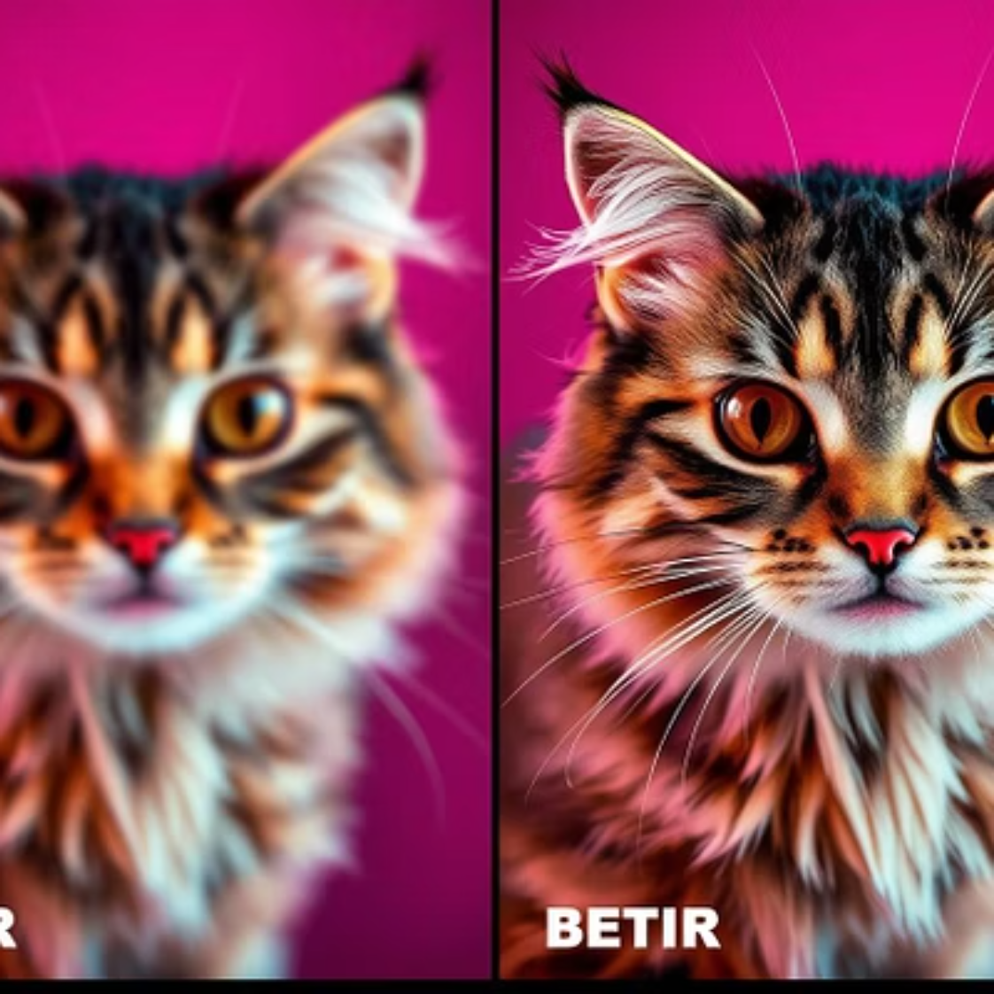
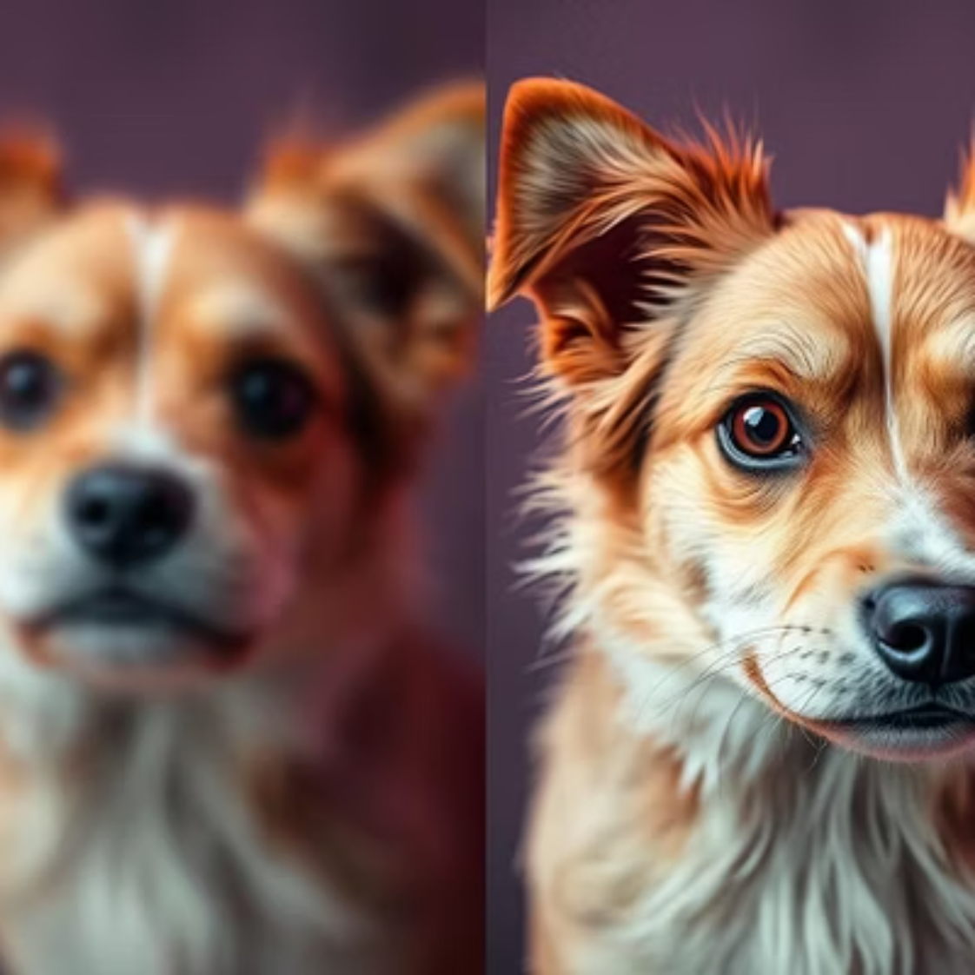
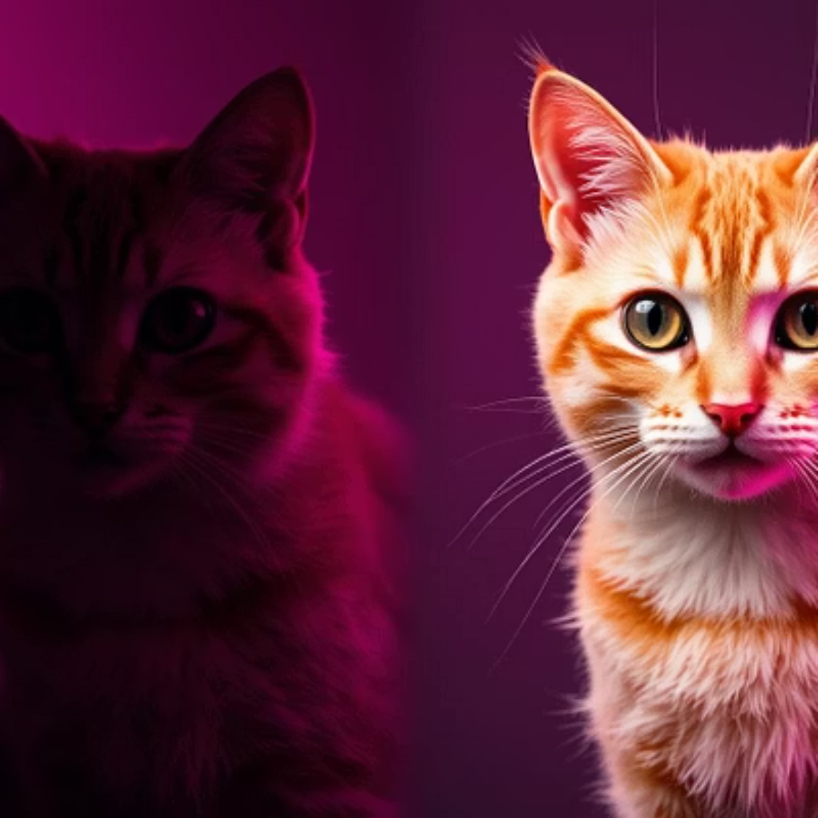
VISUALISING SUCCESS
Enhanced Image Samples & Results Analysis
The true measure of our model's success lies in the visual quality of the clarified images. Through extensive experimentation and analysis, our CNN has demonstrated a remarkable ability to restore clarity, sharpness, and detail to degraded cat and dog images. Below are compelling examples showcasing the significant improvements:
These visual improvements are supported by quantitative metrics, indicating substantial gains in image quality.

Slide 9
OVERCOMING HURDLES
Challenges and Future Scope in Image Clarification
Despite significant advancements, image clarification using CNNs still presents challenges. One major hurdle is generalisation to extremely diverse and unseen degradation types. Additionally, balancing computational efficiency with model complexity remains crucial for real-time applications. Looking ahead, the field offers exciting avenues for further research and development.
Handling Extreme Degradation
1
Developing models robust enough for severely blurred or corrupted images.
Real-time Processing
2
Optimising models for faster inference without sacrificing quality, for live applications.
Perceptual Quality Metrics
3
Improving evaluation metrics to better align with human perception of image quality.
Multi-Degradation Learning
4
Creating models that can simultaneously address multiple types of degradation (e.g., blur and noise).

Slide 10
CONCLUSION
Concluding Insights & Open Floor for Questions
Our project successfully demonstrates the efficacy of CNNs in clarifying images of cats and dogs, delivering visually superior results and highlighting the power of deep learning in image enhancement. The journey from understanding degradation to designing a tailored architecture and optimising its performance has been insightful. We believe this work lays a strong foundation for future advancements in computational photography and computer vision.
"The clarity of a vision depends on the sharpness of its image."
Thank you for your time and attention. We are now open for any questions you may have.

